Slide 1
Being a good ally to people with lived experience
Mary O’Hagan
Executive Director Lived Experience

Slide 2
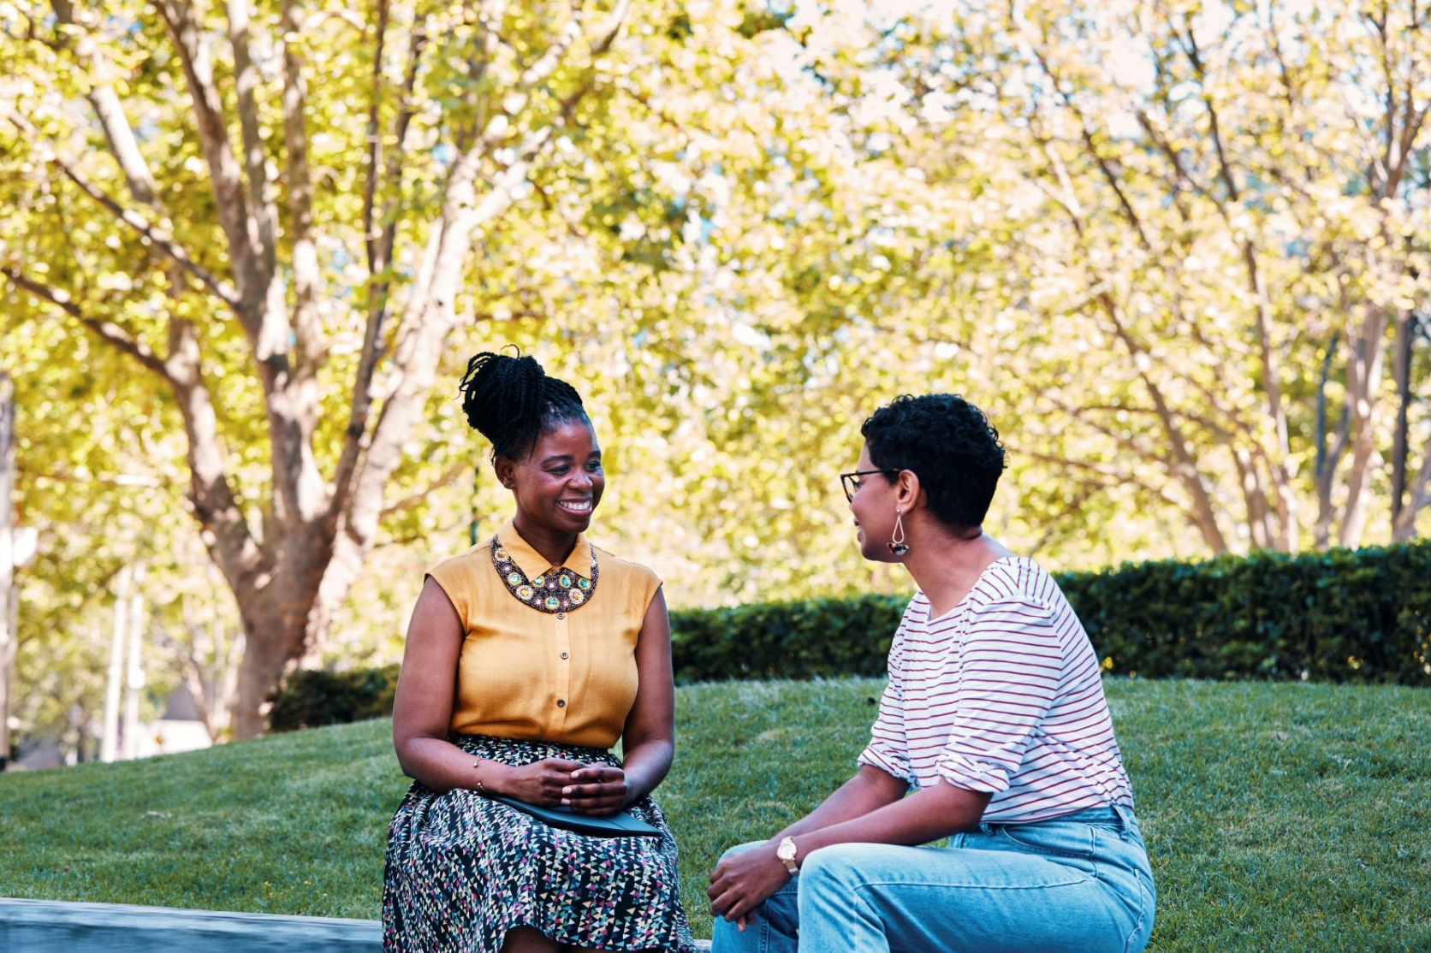
Acknowledgement
Acknowledgement of Country

Slide 3
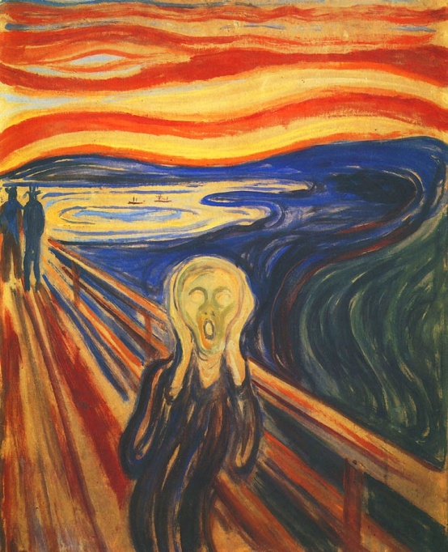
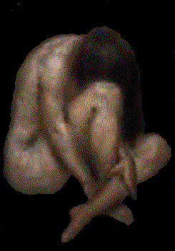
About me

Slide 4
Lived experience, allyship and partnership

Slide 5
Quote
‘The ultimate tragedy is not the oppression and cruelty by the bad people but the silence over that by the good people’ – Martin Luther King

Slide 6
What is allyship?
Allyship describes the sustained efforts by people with relative privilege who work in partnership with marginalised groups to advance their interests, equity and inclusion.
Lived experience movements have always depended on allies – people who ask, listen, show up and speak up.

Slide 7
What do we mean by lived experience?
Lived experience:
Personal knowledge about the world gained through first-hand experience rather than through representations constructed by other people.
Usually refers to challenging or traumatic life experiences that have had a direct impact on people.
In our context lived experience includes people with experience of mental distress, suicidality and/or addiction as well as their families, kin and supporters.

Slide 8
Mental health lived experience history
International consumer movement since 1970s
Consumer and carer peak organisations since 1980s
Consumer and carer participation in state and federal policy since early 1990s
Peer workforce development since 2010s

Slide 9
Engagement

Slide 10
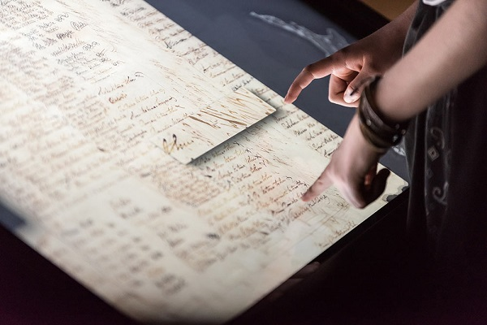
Partnership
Engagement – the more powerful party decides on the terms of engagement.
Partnership – both parties decide on the terms of engagement:
Co-governance
Self-determination
Equity

Slide 11
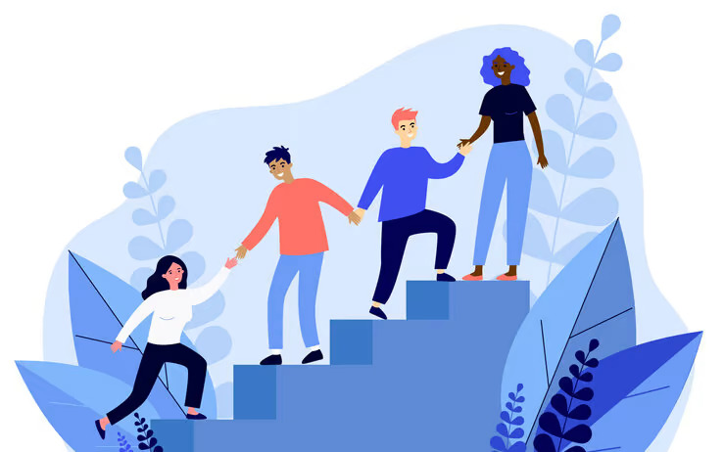
Partnership at all levels
One to one interactions while using services
Delivering services and supports
Management
Governance and system stewardship

Slide 12
How to be a good ally

Slide 13
Four phases
Ask
Listen
Speak up
Show up

Slide 14
Seven principles
Acknowledge privilege and system harm
Educate yourself on lived experience world views
Establish trust and listen to feedback
Ensure lived experience is ‘in the bloodstream’
Call out exclusion and discrimination
Create opportunities for development and leadership
Build a community of allies

Slide 15
1. Acknowledge privilege and system harm
Those of us with relative privilege have often benefited from the same system that has harmed others.
This can be an uncomfortable realisation but relative privilege does not mean we are bad people.

Slide 16
2. Educate yourself on lived experience world views
Get to know people with lived experience:
Be open and curious
Listen deeply to their stories
Absorb lived experience perspectives
Ask questions

Slide 17
3. Establish trust and listen to feedback
Work at establishing trust
Stay aware of the ‘emotional labour’ of carrying lived experience perspectives
Listen deeply to critical feedback
Take time to understand
Accept criticism as a gift

Slide 18
4. Ensure lived experience is ‘in the bloodstream’
Within your sphere of influence:
Promote lived experience partnerships
Apply ‘nothing about us without us’
Ensure people with lived experience are fully ‘in the room’:
Do they set the agenda and the language?
Are they visible and heard?
Is it safe for them?

Slide 19
5. Call out exclusion and discrimination
Acknowledge your own prejudices and biases.
Don’t just leave it to people with lived experience to call out exclusion and discrimination:
Point it out in the moment if possible.
Work with lived experience people to develop responses.
Don’t say ‘I’m sorry that happened’ and walk away.

Slide 20
6. Create opportunities for development and leadership
Within your sphere of influence ensure lived experience people:
Are growing in their presence
Are paid fairly for their time
Get supervision and support
Have opportunities to lead

Slide 21
7. Build a community of allies
Get together with other allies to:
Discuss complexities and problems
Create approaches to allyship
Support each other

Slide 22
Case study – how could allies
Peer work team:
Little training and no supervision
Low status, low pay, poor retention and no career pathway
Lack of understanding about peer support as a discipline
Poor occupational identity with risk of co-optation into clinical world view
Lack of structural integration of peer support into rest of service
How can you be an ally, within in your sphere of influence, to support the strengthening of the peer work team?

Slide 23
Thank you
Email: mary.o’hagan@health.vic.gov.au

