Slide 1
Drug induced psychosis
Dr stuti Jindal (psychiatry registrar)

Slide 2
Substance use trends in australia

Slide 3
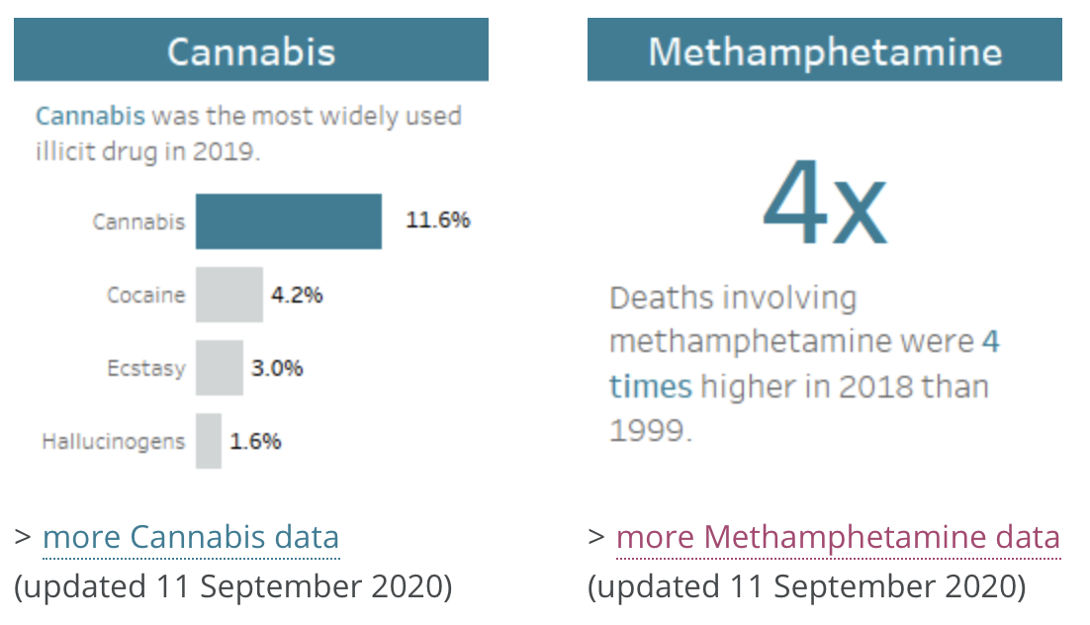
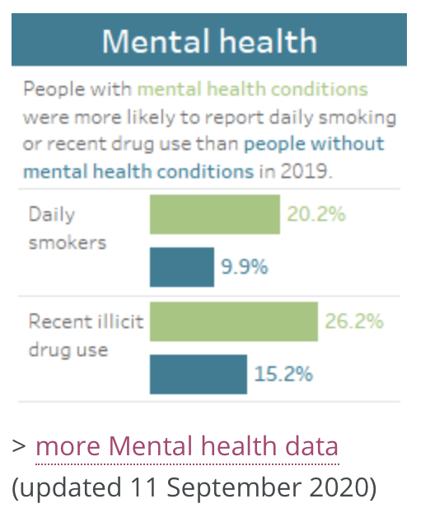
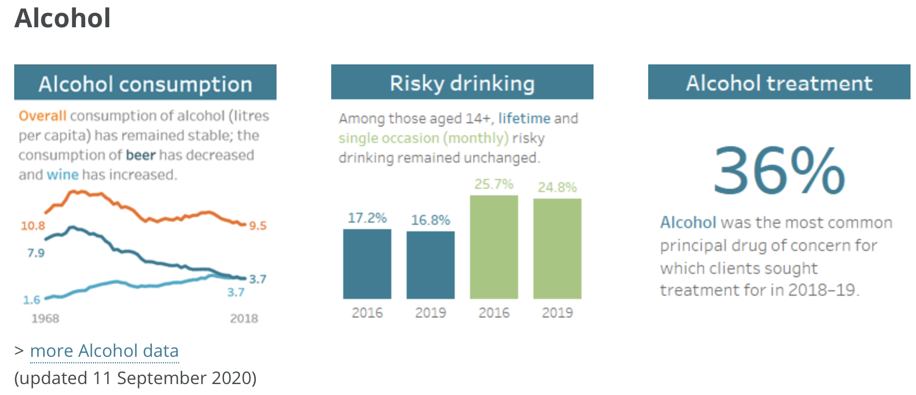

Slide 4
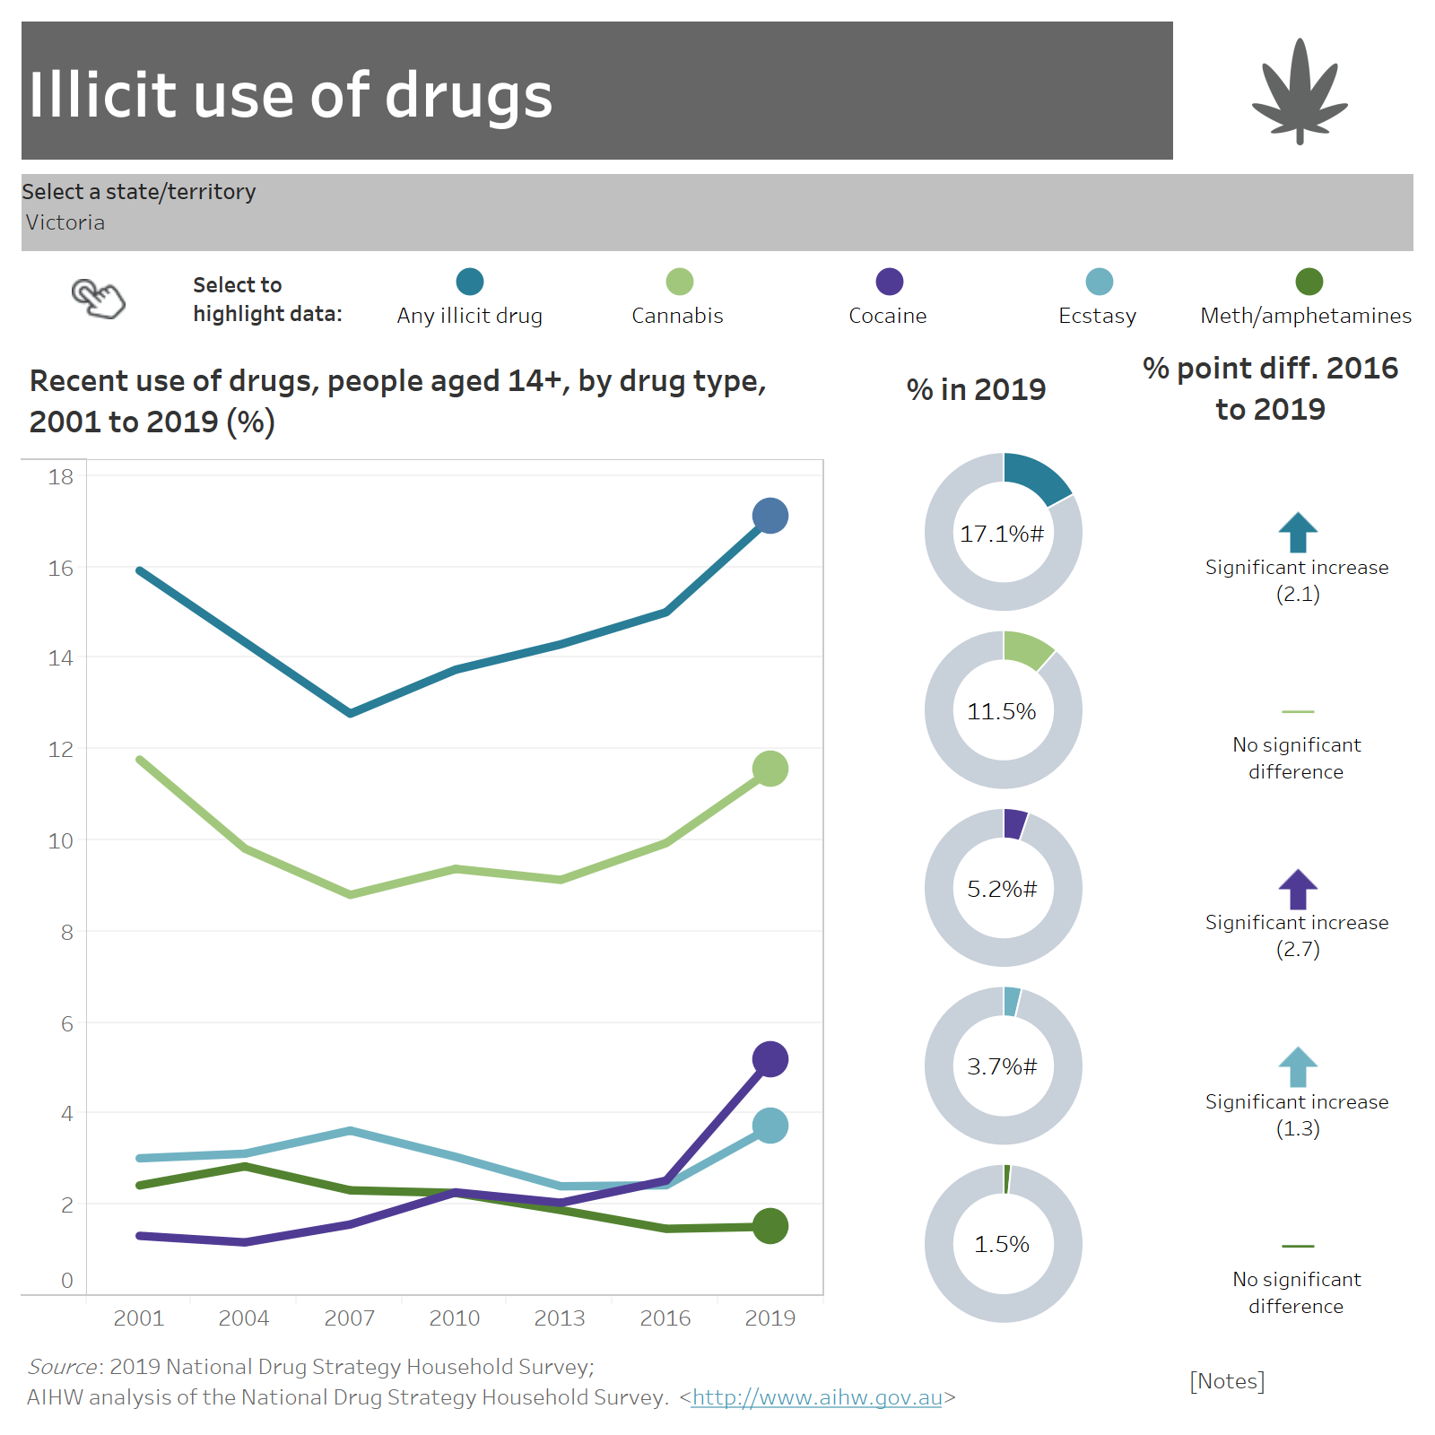

Slide 5
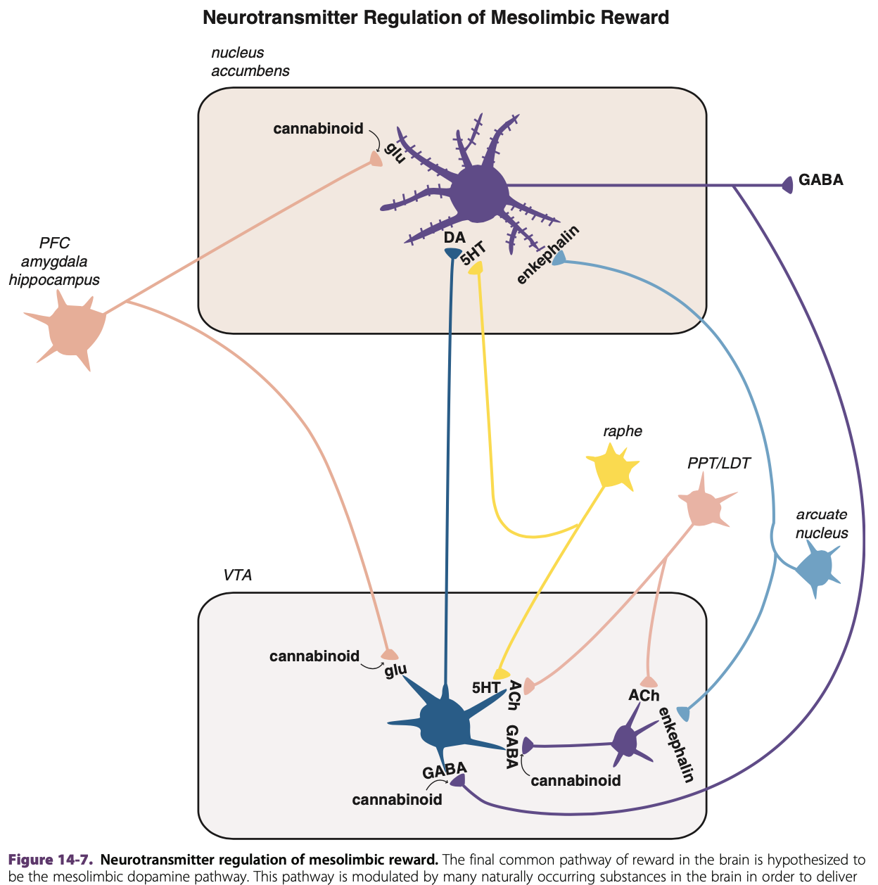
Neural pathways

Slide 6
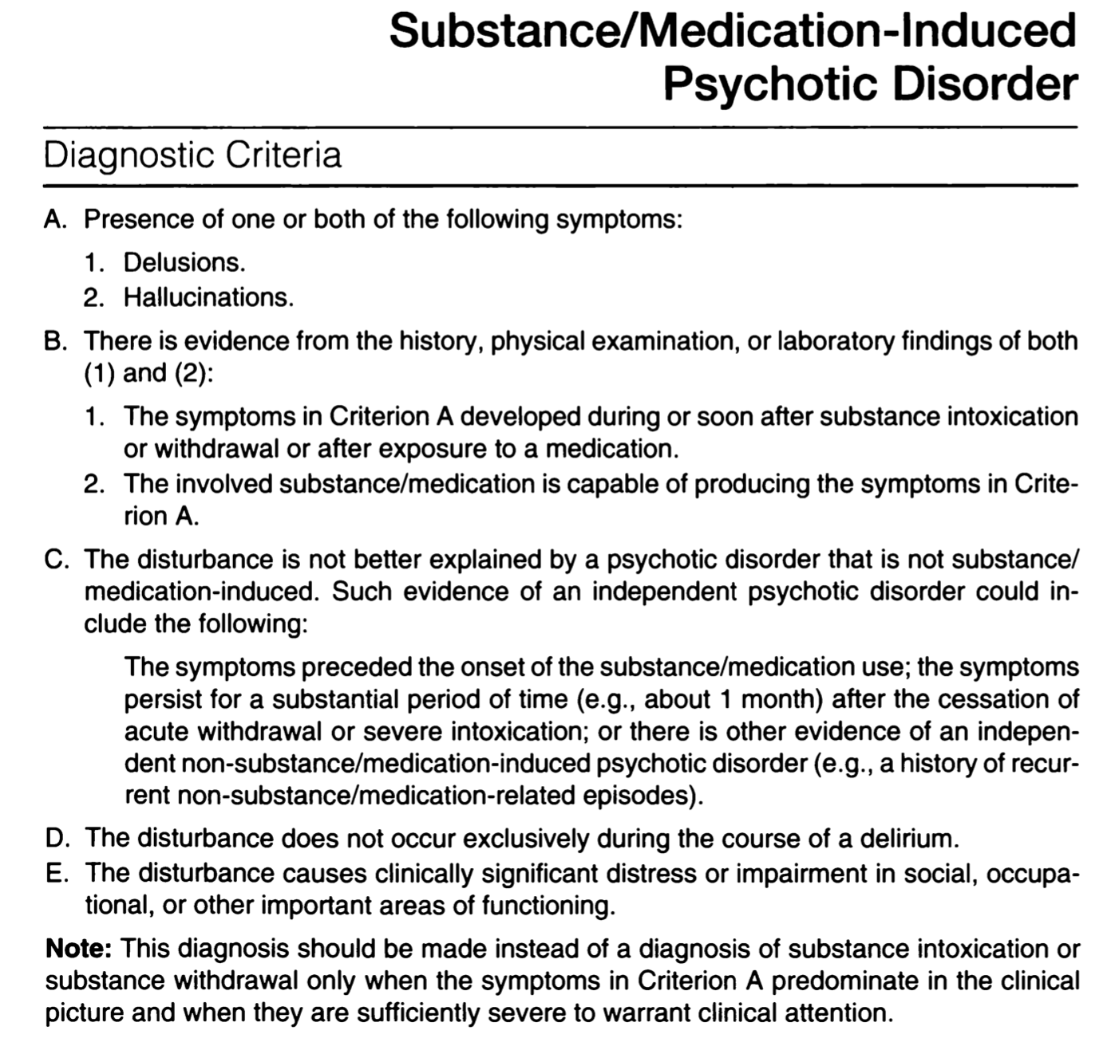

Slide 7
ICD-10

Slide 8
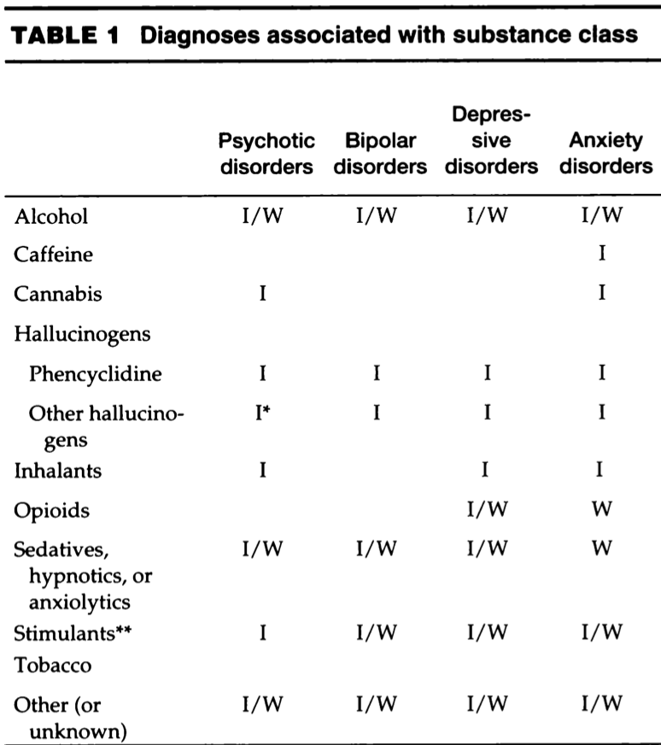

Slide 9
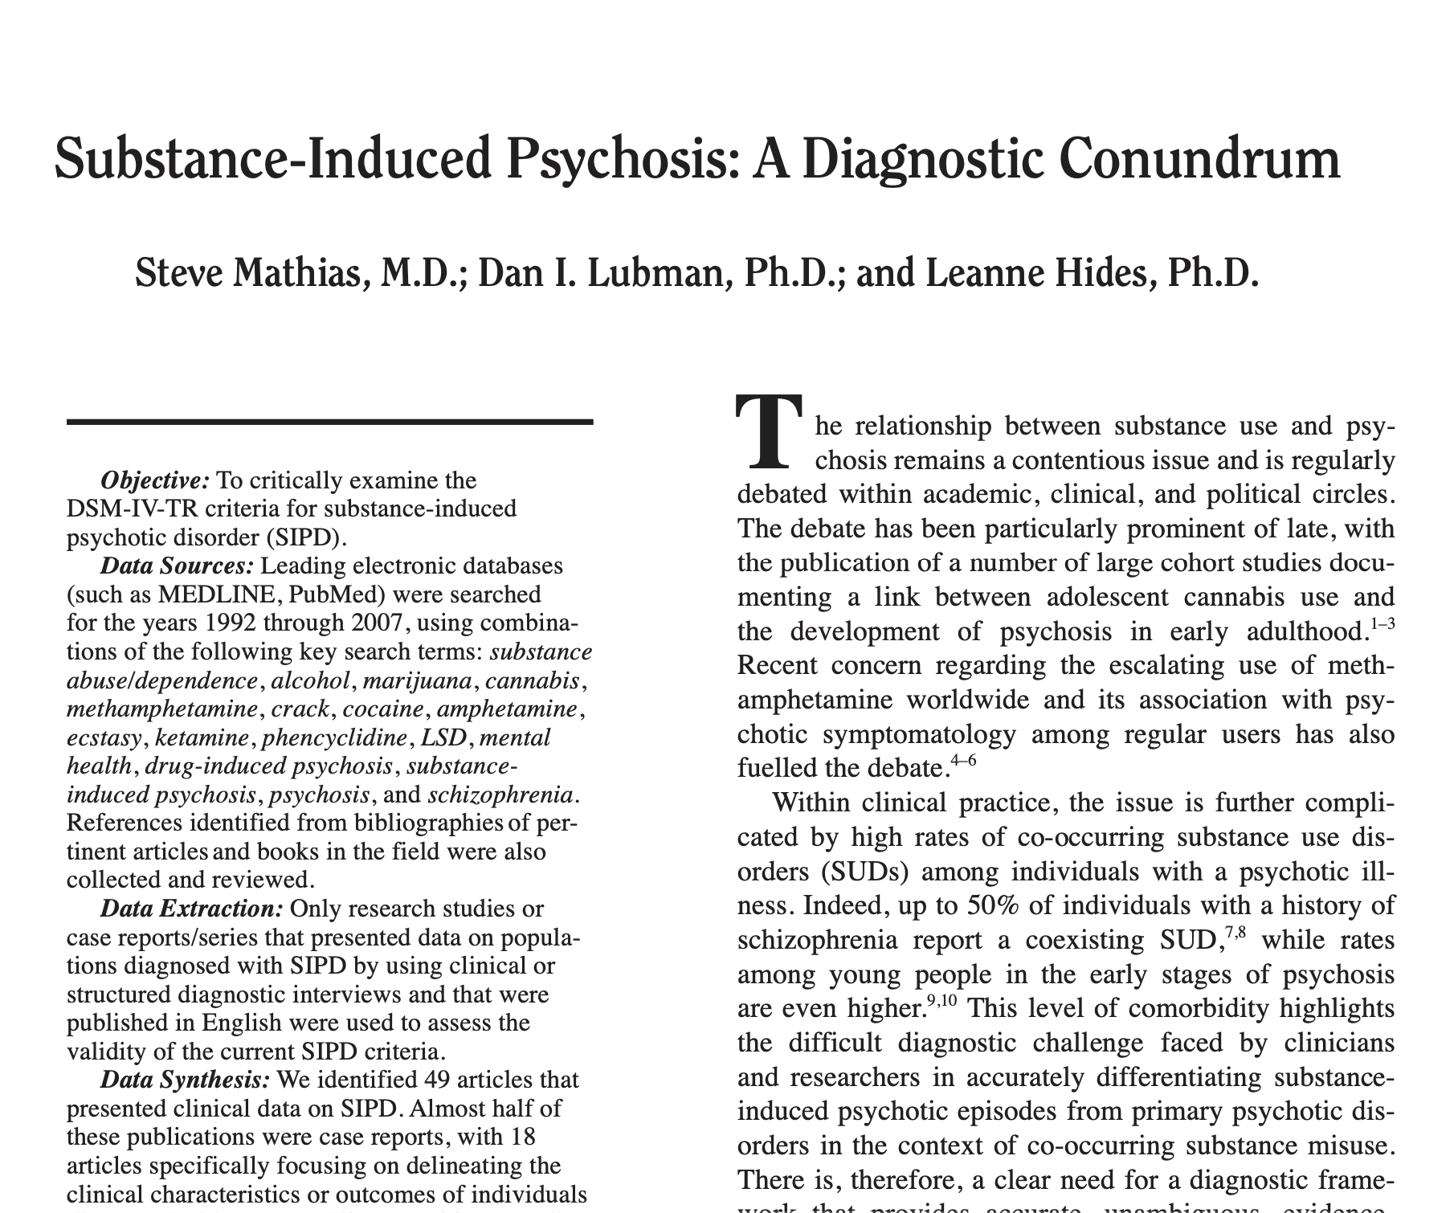
Exclusion of other psychotic features – negative symptoms, disorganized speech.
Ambiguity around onset of symptoms ‘during or soon after substance intoxication or withdrawal’. What about substance use disorder not sufficing criteria for I/W?
Distinguishing from primary psychotic disorders. Duration of symptoms persistence post substance I/W - ‘about a month’ after substance cessation. Some chronic users can have symptoms lasting over 1 month. ?long lasting symptoms or precipitation of development of a primary psychotic disorder.

Slide 10
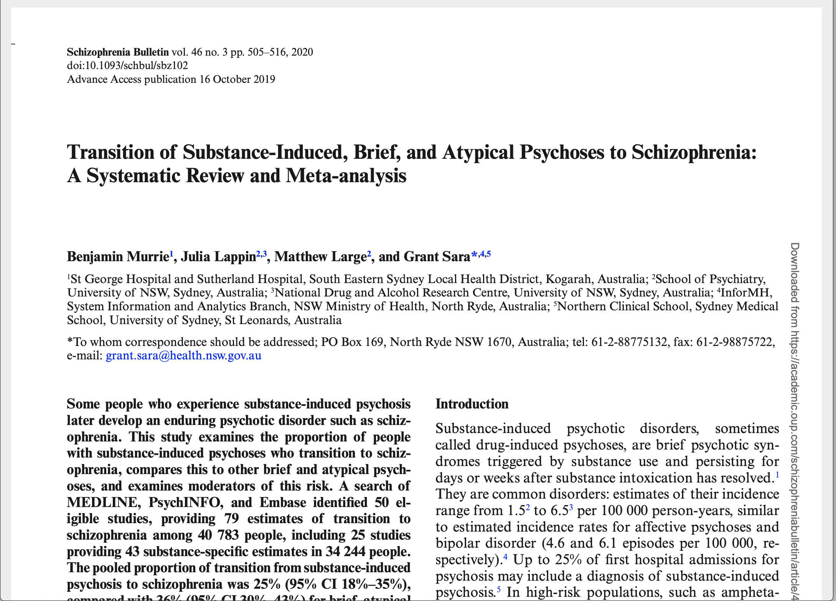
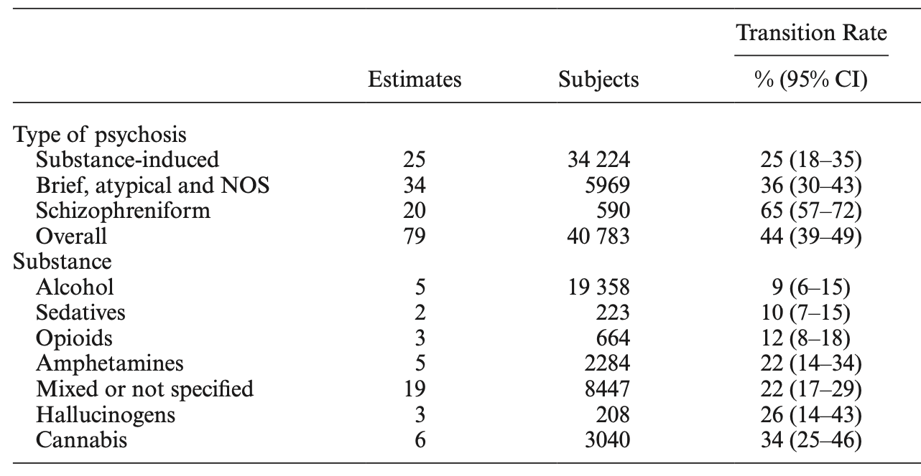
Overall 25% of people with substance induced psychosis had a follow-up diagnosis of schizophrenia.
Highest for cannabis induced psychoses (34%), intermediate for amphetamines and hallucinogens (22% and 26%) and low for alcohol (9%).
Significant heterogeneity of estimates, and the likelihood of transition to schizophrenia was not predicted by sex, country, study setting, urban or rural location, diagnostic system, diagnostic methods or completeness or duration of follow-up.

Slide 11
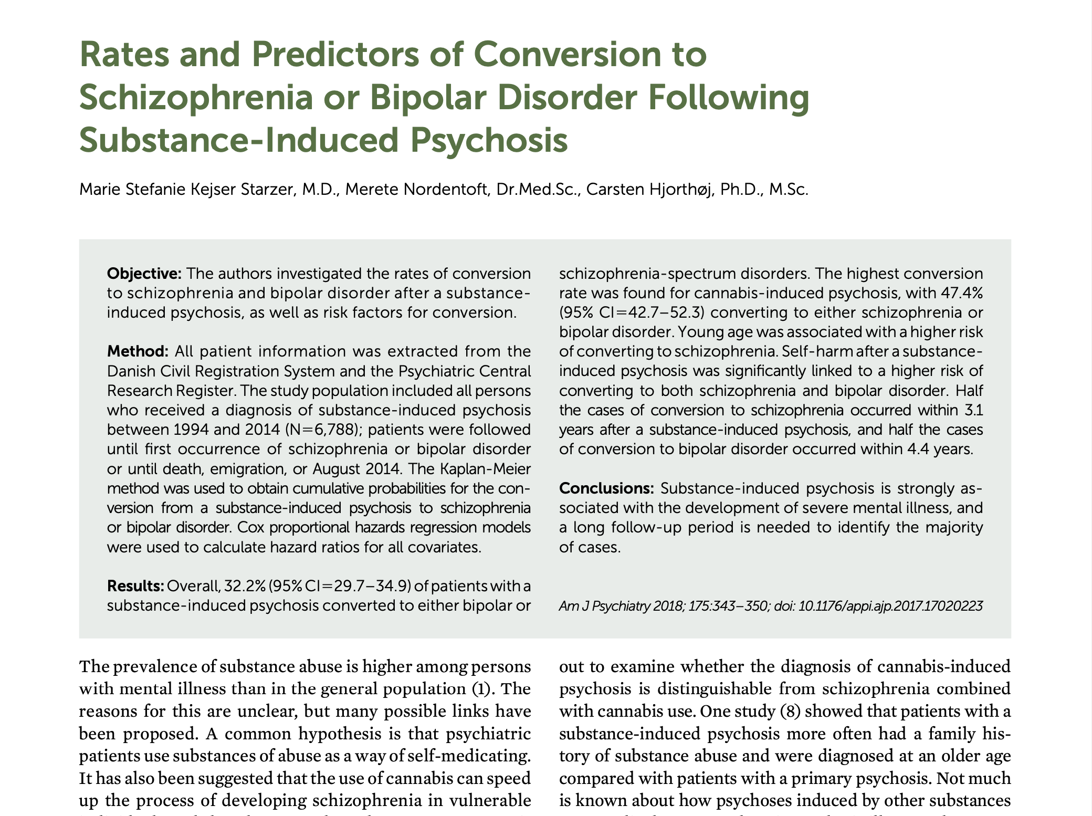
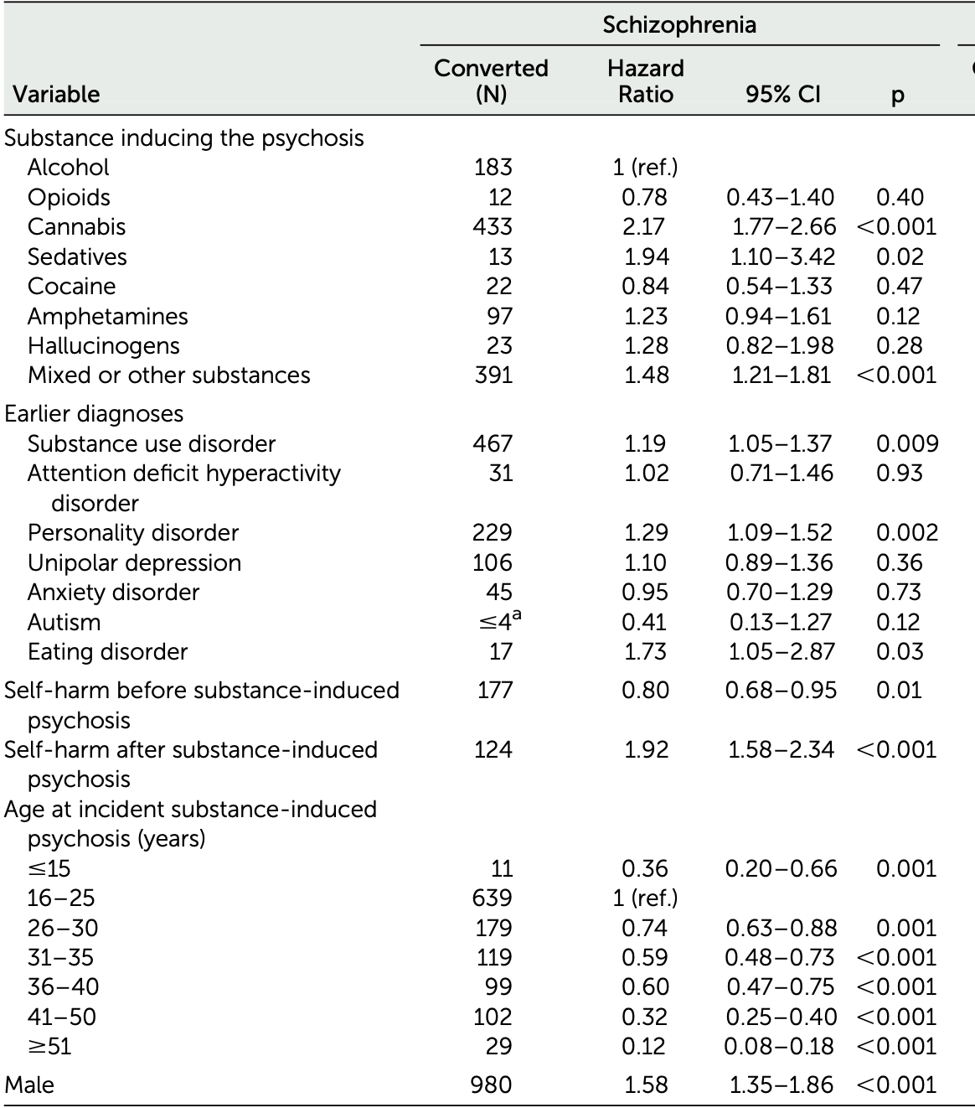
Danish Civil Register study – 10 years.
Overall 32.2% of patients with SIPD converted to either schizophrenia spectrum or bipolar disorders.
Highest rate of conversion was a/w cannabis induced psychosis 47.4%
50% of the conversion to schizophrenia occurred within 3.1 years, and to bipolar in 4.4 years. And for males with cannabis induced psychosis, 50% conversion to schizophrenia was in 2.0 years.

Slide 12
Implications for practice
Should there be changes to the diagnostic criteria to make it more practicable and less ambiguous? Inclusion of SUD, and clarity on duration.
Patients with persistent psychosis and regular substance use - ?PPD or DIP
Treatment and follow-up implications, esp. considering the conversion rates and possible predictors associated.

